Slide 1




RAJEEV INSTITUTE OF TECHNOLOGY, HASSAN.
DEPARTMENT OF COMPUTER SCIENCE AND ENGINEERING
COMPUTER GRAPHICS AND IMAGE PROCESSING MINI PROJECT
“RECOGNITION OF FACE EMOTION THROUGH IMAGE PROCESSING”
UNDER THE GUIDANCE OF,
Mr. SANJAY M
DEPT. OF CSE
RIT , HASSAN
SUBMITTED BY,
UMME KULSUM(4RA21CS107)
VARSHITHA M(4RA21CS112)

Slide 2
CONTENTS
ABSTRACT
INTRODUCTION
PROPOSED SYSTEM
CHALLENGES AND LIMITATIONS
FUTURE DIRECTIONS AND RESEARCH
APPLICATIONS

Slide 3
ABSTRACT
The project “RECOGNITION OF FACE EMOTION THROUGH IMAGE PROCESSING” is used to demonstrate the use of OpenCV functions that is defined in OpenCV. Our objective is to develop an effective system for facial emotion recognition through image processing techniques. Leveraging OpenCV and deep learning methodologies, the system will preprocess facial images, detect key facial features, and classify emotions such as happiness, sadness, anger, surprise, fear, and neutrality. By training machine learning models on annotated datasets, the goal is to achieve robust accuracy in real-time emotion detection applications. This research seeks to enhance human-computer interaction, healthcare diagnostics, and psychological research by providing a reliable tool for understanding and responding to emotional cues from facial expressions.

Slide 4
INTRODUCTION TO OPENCV
OpenCV (Open-Source Computer Vision Library) is a powerful open-source library for computer vision and machine learning. Developed by Intel, it provides a comprehensive set of tools for image processing, video analysis, and real-time computer vision applications, supporting multiple programming languages like Python, C++, and Java.
OpenCV is a versatile library for image processing, video analysis, and object detection. It is widely used for tasks such as face detection and recognition and motion tracking.
Key Features of OpenCV:-
Cross-Platform Support
Wide Range of Applications
Extensive Library
C++, Python, and Java Interfaces
Real-Time Capabilities

Slide 5


INTRODUCTION
Recognizing facial emotions is a growing field that combines artificial intelligence (AI) and computer vision. This technology allows machines to understand and respond to human emotions by analyzing facial expressions instantly.
Emotions conveyed through facial expressions are particularly crucial, as they provide immediate, non-verbal cues about an individual's feelings and intentions.
Real-time facial emotion recognition can enhance how we interact with computers, making these interactions more natural and intuitive.
These systems use complex algorithms to analyze facial features and expressions, identifying emotions such as happiness, sadness, anger, surprise and fear.

Slide 6
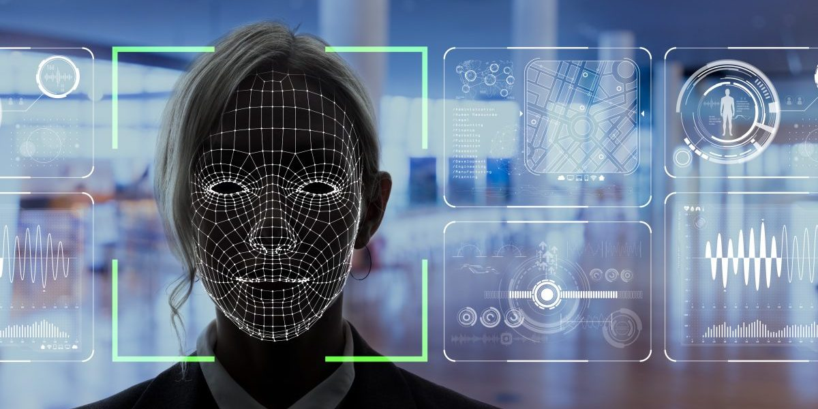
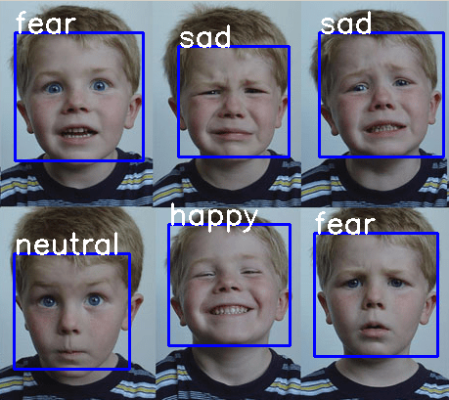
How Facial Emotion Recognition Works ?
Image Capture: A camera captures an image or video of a face in real time.
Face Detection: Software identifies and locates faces within the image.
Facial Landmark Detection: Key points on the face (like eyes, nose, and mouth) are identified.
Feature Extraction: The system analyzes facial features and expressions.
Emotion Classification: Happy, sad, angry, fear, surprised.
Output: The system outputs the detected emotion in real-time.

Slide 7


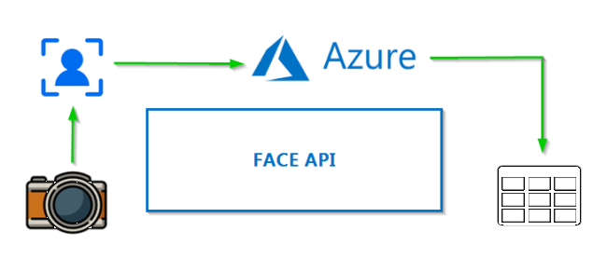

Case Studies and Real-World Examples
Affectiva
Use Case: Monitoring driver emotions in cars.
Outcome: Increased safety by alerting drivers when they are drowsy or distracted.
Microsoft Azure Face API
Use Case: Analyzing customer emotions during service calls.
Outcome: Improved customer service by tailoring responses based on detected emotions.
Apple Face ID
Use Case: Creating personalized Animojis that mimic user expressions.
Outcome: Enhanced user experience with interactive and fun messaging features.

Slide 8
HARDWARE AND SOFTWARE REQUIREMENTS
Hardware Requirements:-
Computer: Modern multi-core CPU, recommended with a GPU (e.g., NVIDIA GTX 1060+).
Webcam: HD webcam (720p or higher) in case of real time analysis.
RAM: At least 8GB (16GB recommended).
Internet: Stable connection for downloading software and models.
Software Requirements:-
Programming Language: Python is widely used for this purpose due to its extensive libraries and community support.
Libraries and Frameworks:
OpenCV: For real-time computer vision tasks, such as capturing video frames.
TensorFlow/Keras : For building and running deep learning models.
Dlib: For face detection and landmark recognition.

Slide 9
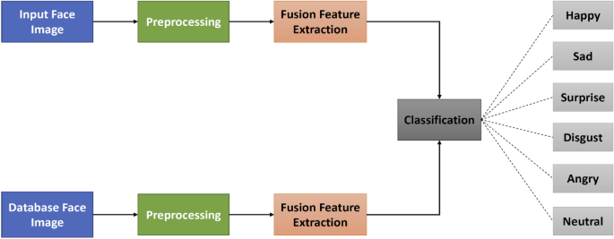
ARCHITECTURE

Slide 10
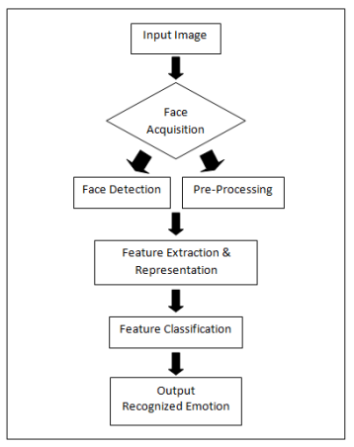
FLOWCHART
This flowchart represents a typical process for facial emotion recognition from an input image.
The process begins with Face Acquisition, where the system captures the face from the input image. This is followed by two parallel steps:
Face Detection, where the face is detected within the image, and Pre-Processing, where the image is prepared for analysis by enhancing quality and normalizing the data.
The next step is Feature Extraction & Representation, where key features of the face are identified and represented in a format suitable for analysis.
These features are then passed through Feature Classification, where they are classified into different emotion categories using machine learning algorithms.
Finally, the system outputs the Recognized Emotion, indicating the identified emotion from the input image.

Slide 11
Challenges and Limitations
1. Privacy Concerns and Ethical Issues:-
Data Collection: Collecting facial data can infringe on personal privacy.
Consent: Ensuring users are aware and have consented to their data being used.
Ethical Use: Avoiding misuse of technology, such as surveillance without consent or emotional manipulation.
2. Data Security Challenges:-
Storage: Securely storing sensitive facial data to prevent unauthorized access.
Transmission: Ensuring data is encrypted during transmission to protect it from interception.
3. Accuracy and Robustness Under Different Conditions:-
Lighting: Variations in lighting can affect the system's ability to detect and analyze emotions accurately.
Occlusions: Objects like glasses, masks, or hair can obstruct facial features, reducing accuracy.
Diversity: Ensuring the system works well across different ages, ethnicities, and facial hair styles to avoid bias and inaccuracies.

Slide 12
Future Directions and ReSEARCH
Healthcare Applications:-
Significant applications in healthcare for monitoring patient emotional states, aiding in mental health diagnosis.
Supporting personalized treatment plans.
Multimodal Emotion Recognition:-
Combining facial expressions with voice and body language.
Using environmental context for better accuracy.
Real-Time Performance Optimization:-
Edge computing to reduce latency.
Hardware acceleration with GPUs.
Robustness and Generalization:-
Adversarial training for better real-world performance.
Domain adaptation for diverse conditions.

Slide 13
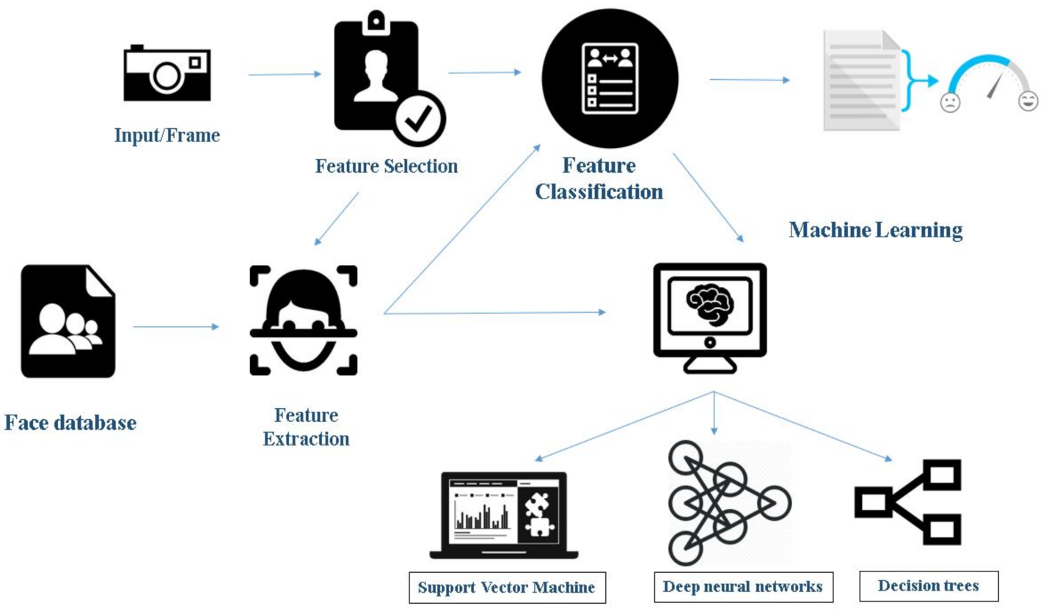

Ethical and Privacy Considerations:-
Privacy-preserving techniques like differential privacy.
Mitigating bias to ensure fairness.
Enhanced User Interaction:-
Emotion-aware applications in gaming and VR.
Improved human-AI collaboration.
Advanced Model Architectures:-
Hybrid models (CNN).
Attention mechanisms for better feature focus.

Slide 14
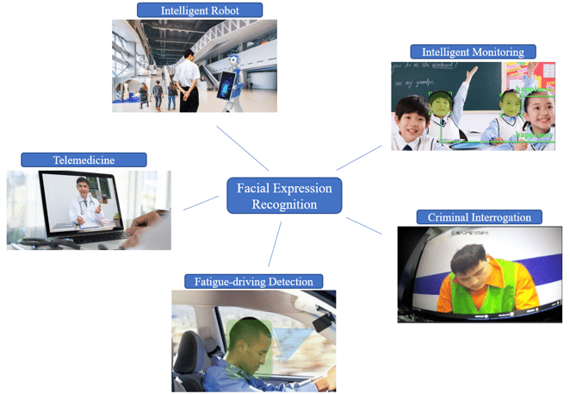
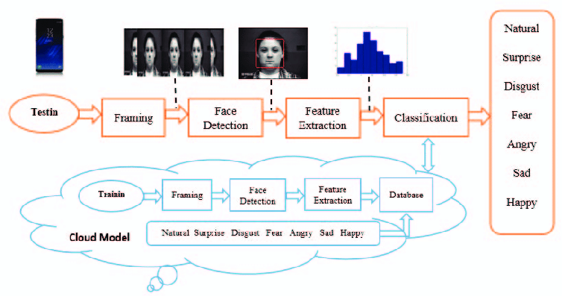
APPLICATIONS
Healthcare and Therapy
Education and Training
Automotive Industry
Human Resources
Virtual Assistants and Chatbots
Entertainment and Gaming
Transportation
Marketing and Customer Service

Slide 15
CONCLUSION
Designing and implementing a project in facial emotion recognition through image processing has been a rewarding experience. We have delved into and comprehensively analyzed the concepts of OpenCV, a pivotal tool for our future endeavors. "Recognition of Face Emotion through Image Processing" aims to create a robust system capable of accurately detecting and categorizing emotions from facial expressions, offering applications in diverse sectors such as human-computer interaction, healthcare, and psychology. The project focuses on developing an OpenCV-based solution that meets user requirements by enhancing image preprocessing, employing effective face detection methods, and implementing machine learning models for emotion classification. This mini project has provided valuable exposure to advanced OpenCV techniques, equipping us with skills essential for developing interactive applications and contributing to the evolving field of emotion-aware technology.

Slide 16


